Slide 1
The Economics of Global
Climate Change
Figures and Tables
By Jonathan M. Harris, Brian Roach, and Anne-Marie Codur
Copyright © 2017 Tufts University Global Development And Environment Institute
www.gdae.org

Slide 2
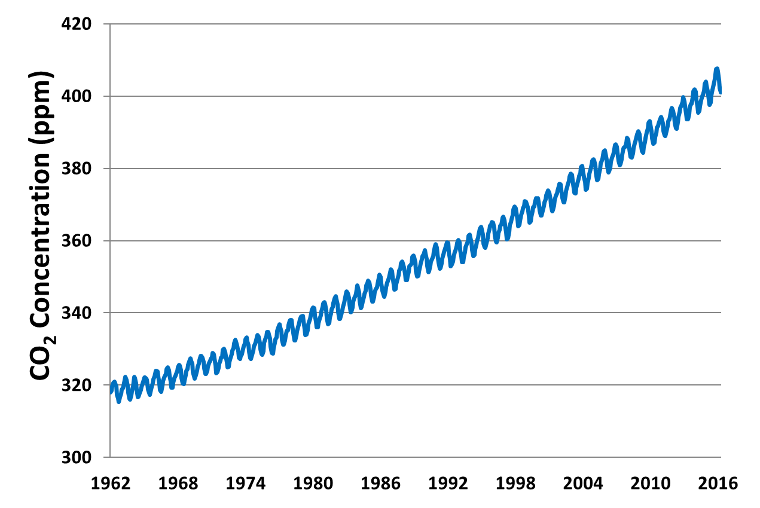
Figure 1: Atmospheric Carbon Dioxide Levels
Source: National Oceanic and Atmospheric Administration, Earth System Research laboratory, Global Monitoring Division http://www.esrl.noaa.gov/gmd/ccgg/trends/data.html
Note: Seasonal variations mean that CO₂ concentrations rise and fall each year with growth and decay of vegetation and other biological systems, but the long-term trend is a steady upward increase due to human emissions of CO₂.

Slide 3
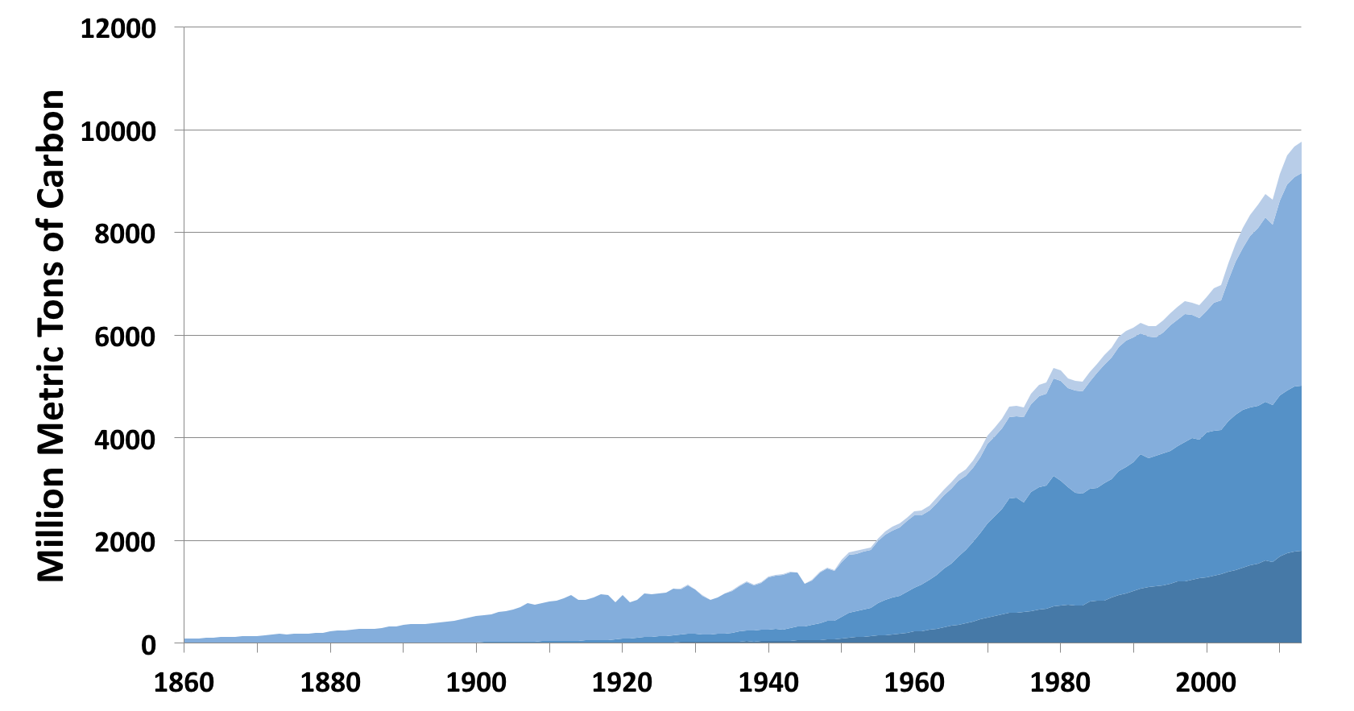
Figure 2: Carbon Emissions from Fossil Fuel Consumption, 1860–2013
Cement production and gas flaring
Coal
Oil
Gas
Source: Carbon Dioxide Information Analysis Center (CDIAC)
http://cdiac.ornl.gov/ftp/ndp030/global.1751_2013.ems
accessed June 2016.
Note: Emissions in million tons (MMt) of carbon. To convert to MMt of CO₂, multiply by 3.67

Slide 4
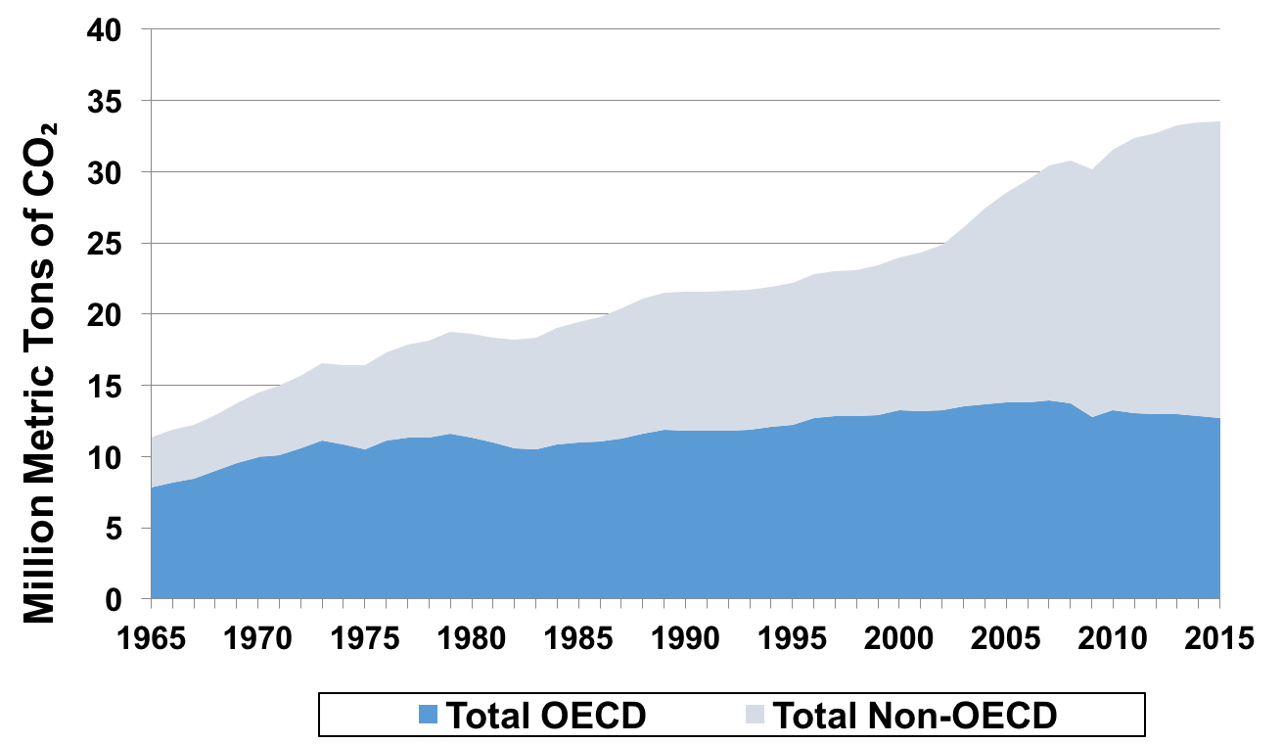
Figure 3: Carbon Dioxide Emissions, 1965-2015,
Industrialized and Developing Countries (Million Metric Tons of CO₂ )
Source: U.S. Energy Information Administration http://www.eia.gov/forecasts/aeo/data/browser/#/?id=10-IEO2016&sourcekey=0 accessed June 2016.
Notes: OECD = Organization for Economic Cooperation and Development (primarily industrialized countries, while non-OECD are developing countries). The vertical axis in Figure 12.3 measures million metric tons of carbon dioxide. (the weight of a given amount of emissions measured in tons of carbon dioxide is about 3.67 times the total weight in carbon). The emissions estimates of the U.S. EIA shown here differ slightly from those of the CDIAC shown in Figure 12.2.

Slide 5
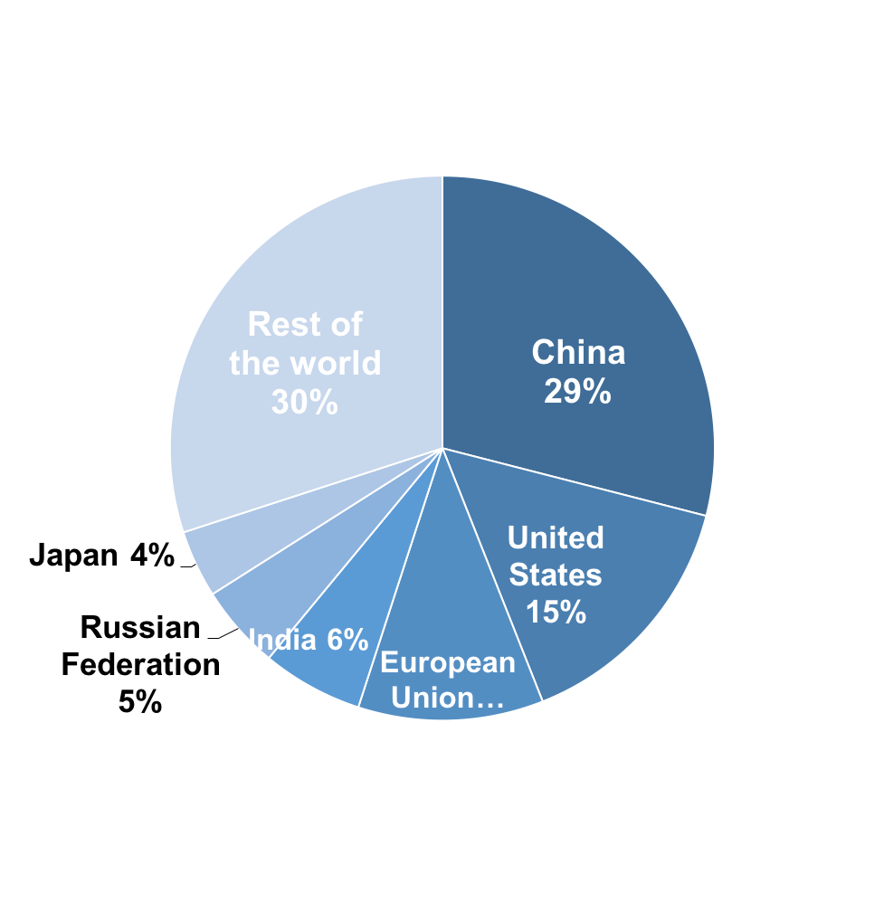
Figure 4: Percentage of Global CO₂ Emissions by Country/Region
Source: Jos G.J. Olivier et al., European Commission’s Joint Research Centre, 2014. “Trends in global CO2 emissions: 2014 Report” http://edgar.jrc.ec.europa.eu/news_docs/jrc-2014-trends-in-global-co2-emissions-2014-report-93171.pdf

Slide 6
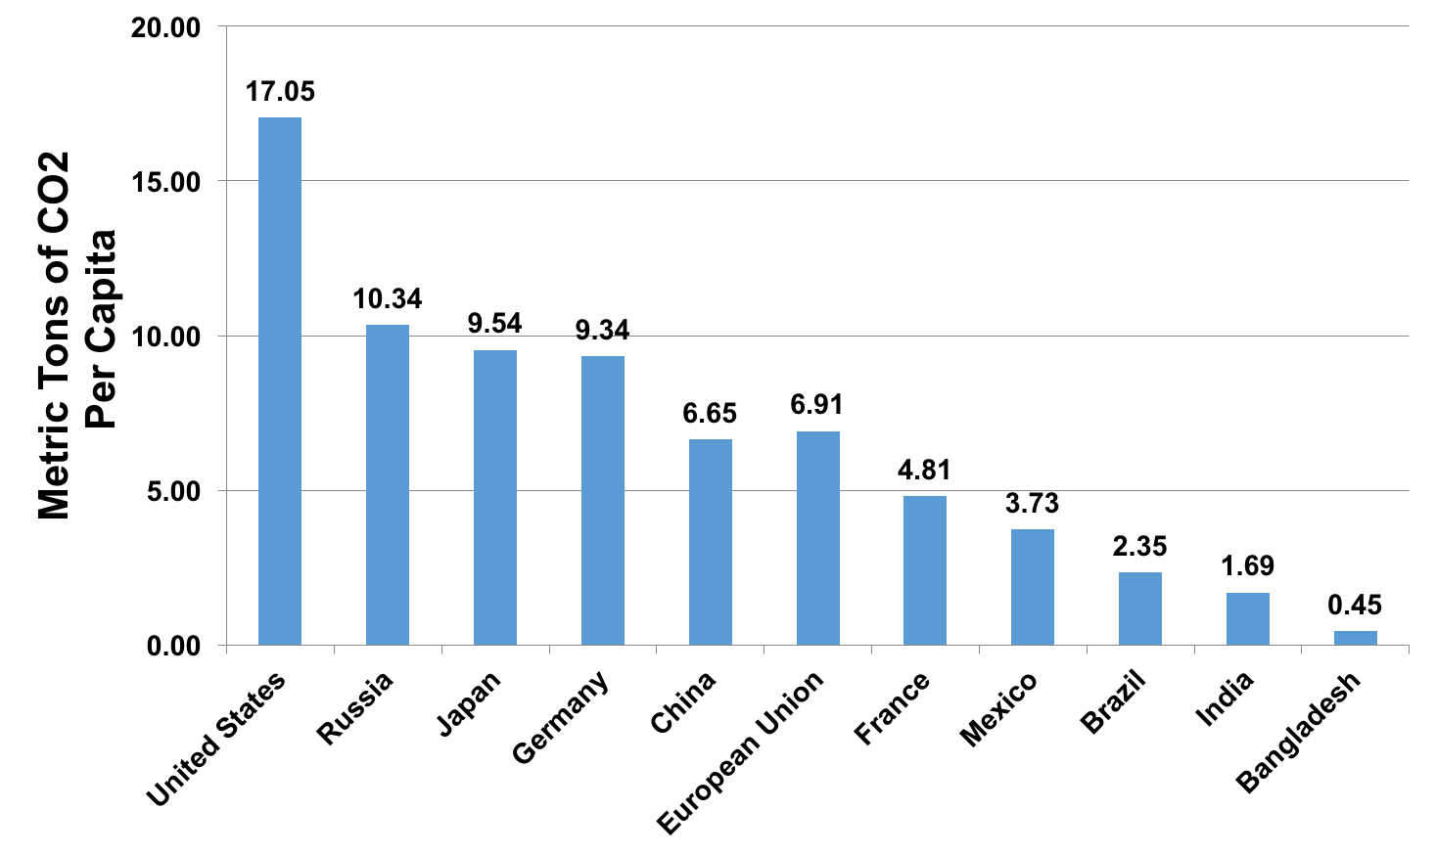
Figure 5: Per-Capita Carbon Dioxide Emissions, by Country
Source: Source: British Petroleum, Energy charting tool 2015.

Slide 7
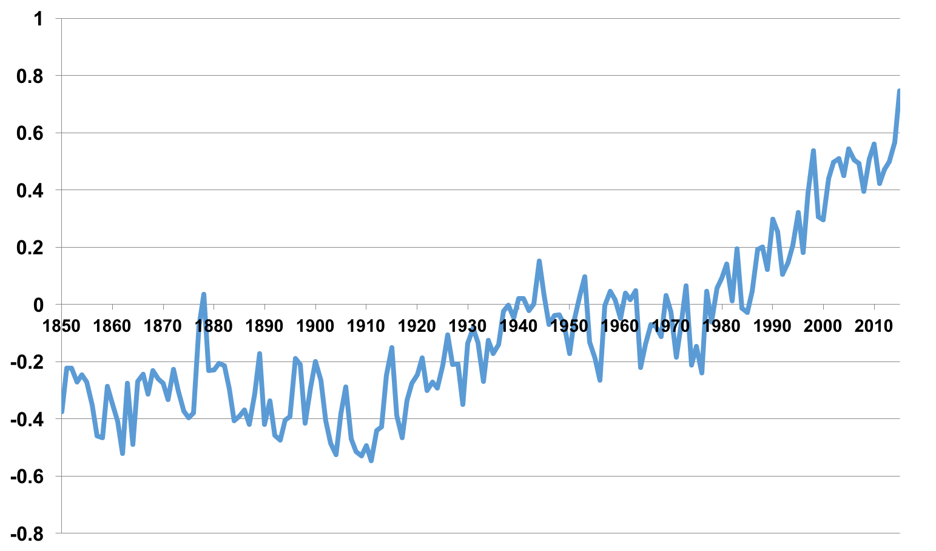
Figure 6: Global Annual Temperature Anomalies (°C), 1850–2015
Source: CDIAC, Global Monthly and Annual Temperature Anomalies (degrees C), 1850-2015, relative to the 1961-1990 mean, May 2016. http://cdiac.ornl.gov/ftp/trends/temp/jonescru/global.txt Note: The zero baseline represents the average global temperature from 1961 to 1990.

Slide 8
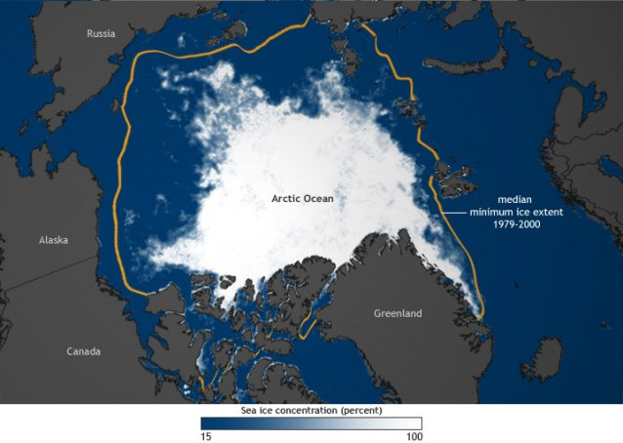
Figure 7: Shrinking Arctic Ice in the Arctic
Source: http://thinkprogress.org/climate/2014/02/18/3302341/arctic-sea-ice-melt-ocean-absorbs-heat/.
Figure is based on data from the National Snow and Ice Data Center. Credit: Climate.gov.

Slide 9
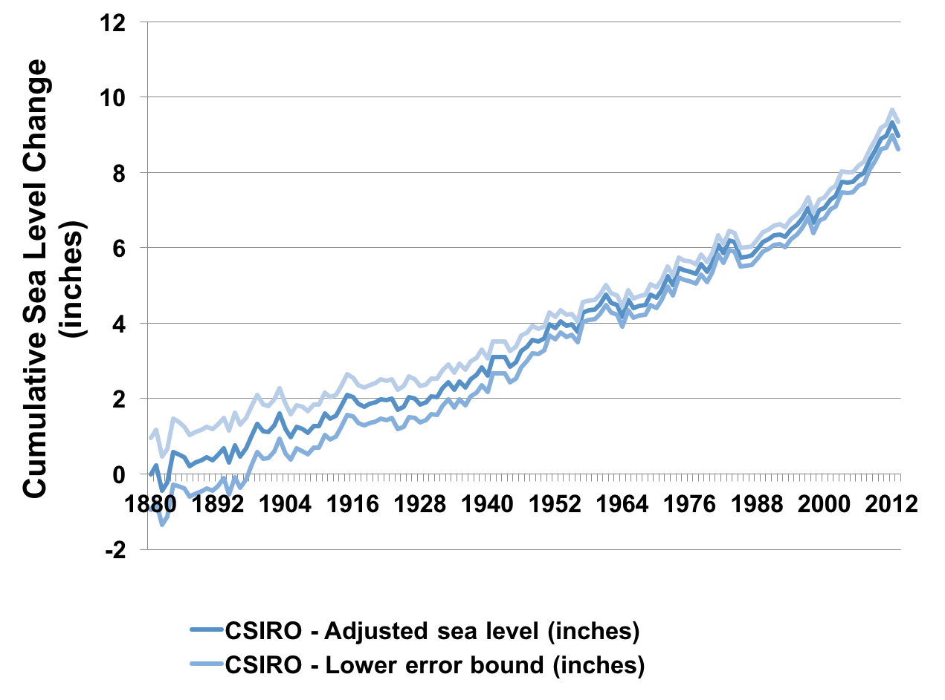
Figure 8: Sea-Level Rise, 1880–2012
Source: IPCC, 2014a
Note: The line in the middle shows an average estimate based on a large number of data sources. Upper and lower lines represent high and low level margins of error (smaller for recent data).

Slide 10
Figure 9: Global Temperature Trends, 1900–2100
6.0
4.0
Global surface temperature change (°C)
2.0
0.0
-2.0
1900
1950
2000
2050
2100
Year
Source: IPCC 2014c, Summary for Policymakers, p. 13.

Slide 11
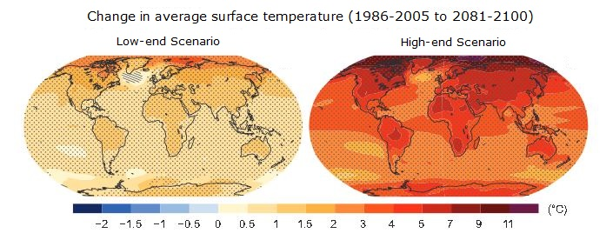
Figure 10: Global Temperature Trends Projected to 2100 – Two Scenarios
Source: IPCC, 2013

Slide 12
Figure 11: The Relationship Between the Level of Greenhouse Gas Stabilization and Eventual Temperature Change
400 ppm CO₂ e
450 ppm CO₂ e
550 ppm CO₂ e
650 ppm CO₂ e
750 ppm CO₂ e
0°C
1°C
2°C
3°C
4°C
5°C
Eventual Temperature change (relative to pre-industrial)
Source: Stern, 2007.
Note: CO₂e = CO₂ equivalent; ppm = parts per million.

Slide 13
Table 1: Possible Effects of Climate Change
 | Eventual Temperature Rise Relative to Pre-Industrial Temperatures
Type of Impact | 1°C | 2°C | 3°C | 4°C | 5°C
Freshwater Supplies | Small glaciers in the Andes disappear, threatening water supplies for 50 million people | Potential water supply decrease of 20–30% in some regions (Southern Africa and Mediterranean) | Serious droughts in southern Europe every 10 years 1–4 billion more people suffer water shortages | Potential water supply decrease of 30–50% in southern Africa and Mediterranean | Large glaciers in Himalayas possibly disappear, affecting ¼ of China’s population
Food and Agriculture | Modest increase in yields in temperature regions | Declines in crop yields in tropical regions (5–10% in Africa) | 150–550 million more people at risk of hunger Yields likely to peak at higher latitudes | Yields decline by 15–35% in Africa Some entire regions out of agricultural production | Increase in ocean acidity possibly reduces fish stocks
Human Health | At least 300,000 die each year from climate–related diseases Reduction in winter mortality in high latitudes | 40–60 million more exposed to malaria in Africa | 1–3 million more potentially people die annually from malnutrition | Up to 80 million more people exposed to malaria in Africa | Further disease increase and substantial burdens on health care services
Coastal Areas | Increased damage from coastal flooding | Up to 10 million more people exposed to coastal flooding | Up to 170 million more people exposed to coastal flooding | Up to 300 million more people exposed to coastal flooding | Sea-level rise threatens major cities such as New York, Tokyo, and London
Ecosystems | At least 10% of land species facing extinction Increased wildfire risk | 15–40% of species potentially face extinction | 20–50% of species potentially face extinction Possible onset of collapse of Amazon forest | Loss of half of Arctic tundra Widespread loss of coral reefs | Significant extinctions across the globe
Sources: IPCC, 2007b; Stern, 2007.

Slide 14
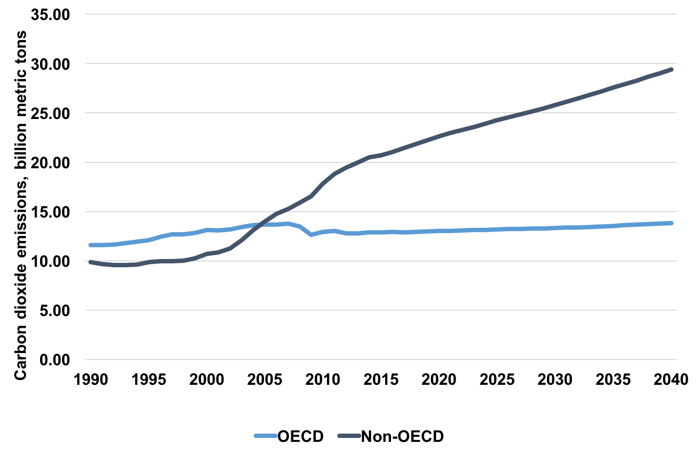
Figure 12: Energy-Related Carbon Dioxide Emissions, Projected to 2040
Source: EIA, 2016.
Note: The Organization for Economic Cooperation and Development (OECD) includes primarily industrialized countries, and non-OECD comprises the rest of the world, including developing countries and including China.

Slide 15
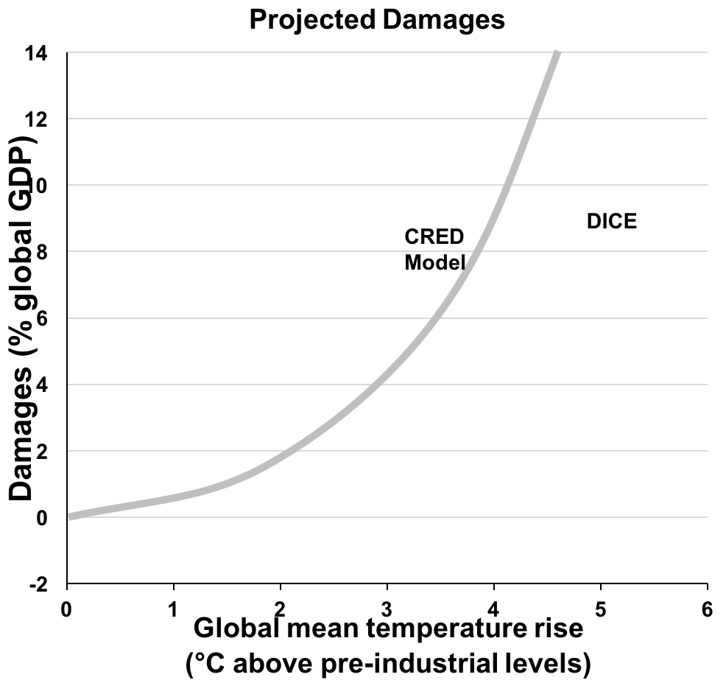
Figure 13: Increasing Damages from Rising Global Temperatures
ENVISAGE Model
Source: R. Revesz, K. Arrow et al., 2014.
http://www.nature.com/news/global-warming-improve-economic-models-of-climate-change-1.14991
Note: The three different models (ENVISAGE, DICE, and CRED) shown in this figure give damage estimates that are similar at low to moderate levels of temperature change, but diverge at higher levels, reflecting different assumptions used in modeling.

Slide 16
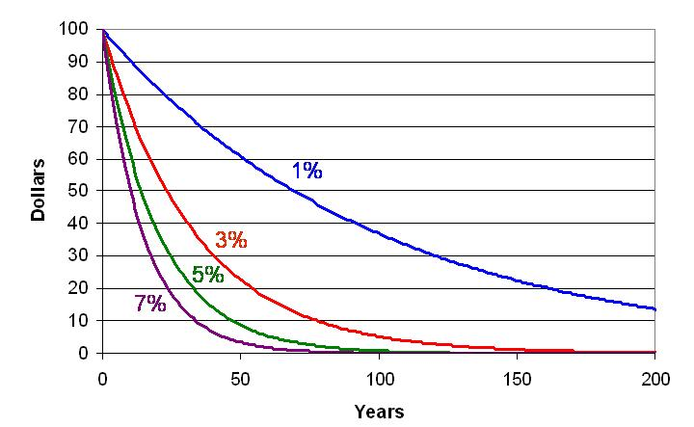
Figure 14: Present Value of a Future $100 Cost or Benefit: The Effects of Different Discount Rates

Slide 17
Table 2: Regional-Scale Impacts of Climate Change by 2080 (millions of people)
Region | Population living in watersheds with an increase in water-resources stress | Increase in average annual number of coastal flood victims | Additional population at risk of hunger (figures in parentheses assume maximum CO₂ enrichment effect)
Europe | 382–493 | 0.3 | 0
Asia | 892–1197 | 14.7 | 266 (–21)
North America | 110–145 | 0.1 | 0
South America | 430–469 | 0.4 | 85 (–4)
Africa | 691–909 | 12.8 | 200 (–2)
Source: Adapted from IPCC, 2007b. Note: These estimates are based on a business-as-usual scenario (IPCC A2 scenario). The CO₂ enrichment effect is increased plant productivity, which at maximum estimates could actually decrease the number at risk of hunger.

Slide 18
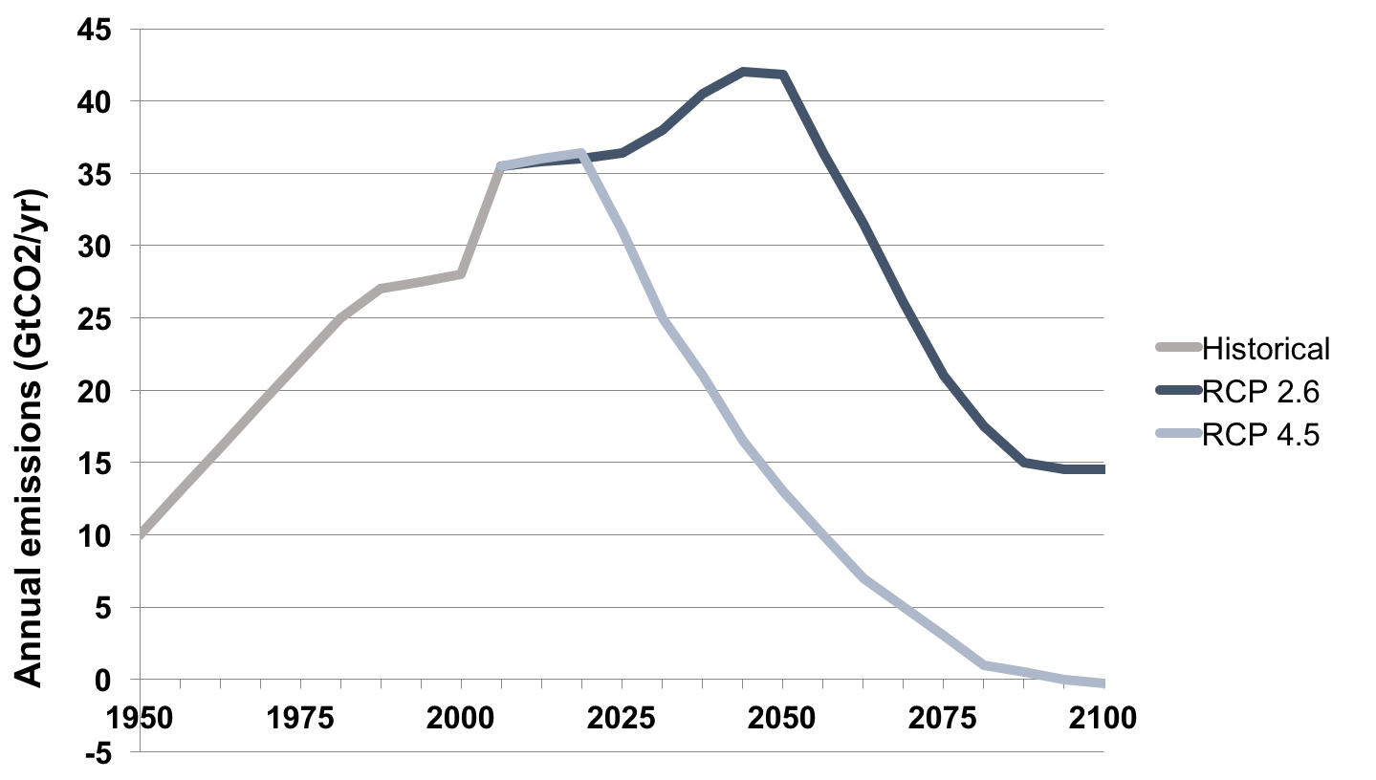
Figure 15: Carbon Stabilization Scenarios: Required Emissions Reductions
Source: IPCC, 2014d, p. 11.
Note: Upper line represents IPCC RCP 4.5 scenario (moderate stabilization in the range of 530 – 580 ppm CO₂ accumulation) and lower line represents IPCC RCP 2.6 scenario (stronger stabilization at 430 – 480 ppm CO₂ accumulation).

Slide 19
Table 3: Climate Change Adaptation Needs, by Sector
Sector | Adaptation strategies
Water | Expand water storage and desalination Improve watershed and reservoir management Increase water-use and irrigation efficiency and water re-use Urban and rural flood management
Agriculture | Adjust planting dates and crop locations Develop crop varieties adapted to drought, higher temperatures Improved land management to deal with floods/droughts Strengthen indigenous/traditional knowledge and practice
Infrastructure | Relocate vulnerable communities Build and strengthen seawalls and other barriers Create and restore wetlands for flood control Dune reinforcement
Human health | Health plans for extreme heat Increase tracking, early-warning systems for heat-related diseases Address threats to safe drinking water supplies Extend basic public health services
Source: IPCC, 2007; IPCC, 2014b.

Slide 20
Table 3 continued: Climate Change Adaptation Needs, by Sector
Sector | Adaptation strategies
Transport | Relocation or adapt transport infrastructure New design standards to cope with climate change
Energy | Strengthen distribution infrastructure Address increased demand for cooling Increase efficiency, increase use of renewables
Ecosystems | Reduce other ecosystem stresses and human use pressures Improve scientific understanding, enhanced monitoring Reduce deforestation, increase reforestation Increase mangrove, coral reef, and seagrass protection
Source: IPCC, 2007; IPCC, 2014b.

Slide 21
Table 4: Alternative Carbon Taxes on Fossil Fuels
Impact of Carbon Price on Retail Price of Coal
kg CO₂ per short ton 2100
tonnes CO₂ per short ton 2.1
$/short ton, $50/tonne tax $105
$/short ton, $100/tonne tax $210
Retail price (2016) per short ton $40
% increase, $50/tonne tax 262.5
% increase, $100/tonne tax 525.0
Impact of Carbon Price on Retail Price of Gasoline
kg CO₂ per gallon 8.89
tonnes CO₂ per gallon 0.00889
$/gal., $50/tonne tax $0.45
$/gal., $100/tonne tax $0.88
Retail price (2016) per gallon $2.20
% increase, $50/tonne tax 20.2
% increase, $100/tonne tax 40.4
Source: Carbon emissions calculated from carbon coefficients and thermal conversion factors available from the U.S. Department of Energy. All price data from the U.S. Energy Information Administration.

Slide 22
Table 4: Alternative Carbon Taxes on Fossil Fuels
Impact of Carbon Price on Retail Price of Natural Gas
kg CO₂ per 1000 cu. ft. 53.12
tonnes CO₂ per 1000 cu. ft. 0.05312
$/1000 cu. ft., $50/tonne tax $2.66
$/1000 cu. ft., $100/tonne tax $5.31
Retail price (2016) $12
% increase from $50/tonne tax 22.1
% increase from $100/tonne tax 44.2
Source: Carbon emissions calculated from carbon coefficients and thermal conversion factors available from the U.S. Department of Energy. All price data from the U.S. Energy Information Administration.

Slide 23
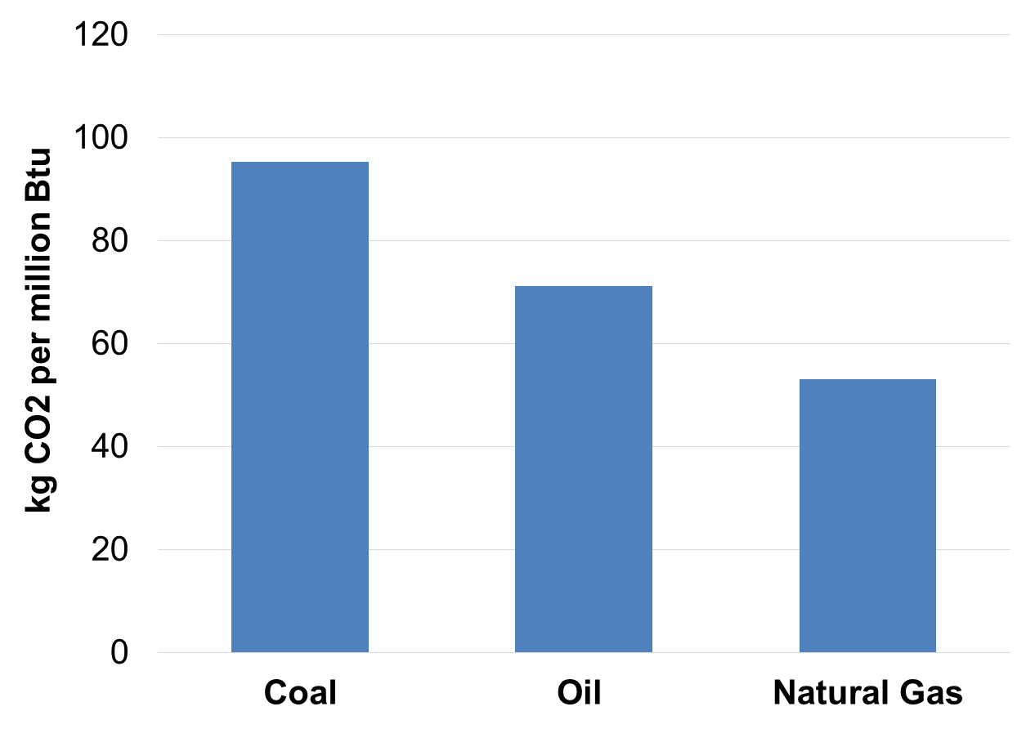
Figure 16: Carbon Content of Fuels
Source: Calculated from U.S. Department of Energy data.

Slide 24



Figure 17: Impact of a Carbon Tax on Gasoline Price
CO₂
One gallon of gasoline = 8.89 kg of CO₂ (0.009 tonnes)
Carbon tax of $50/tonne = $0.44/gallon
With a price of $2.20/gallon, this raises prices by 20%.
Source: Calculated from U.S. Department of Energy data.

Slide 25
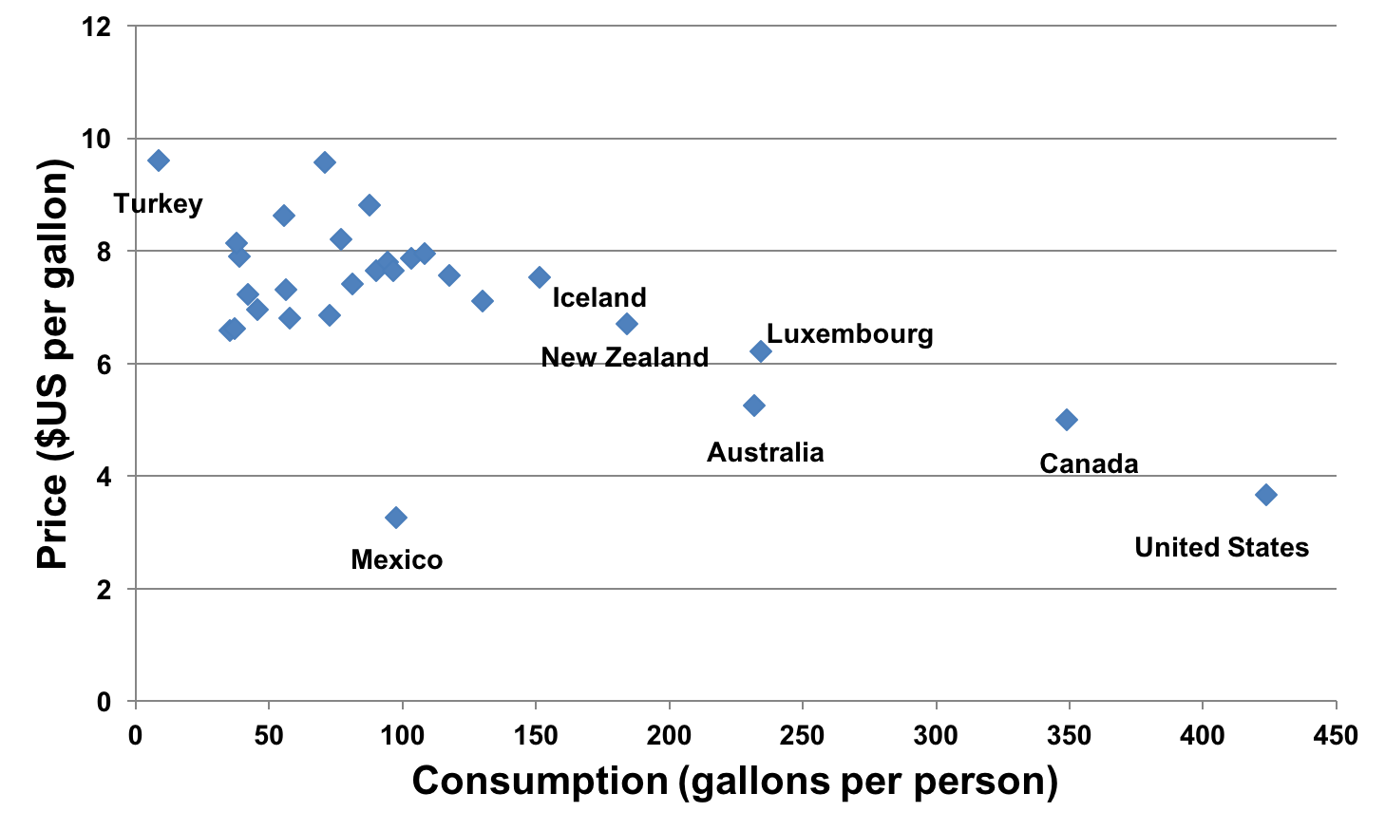
Figure 18: Gasoline Price Versus Consumption in Industrial Countries, 2012
Europe
Sources: U.S. Energy Information Administration database, International Energy Statistics; GIZ, International Fuel Prices 2012/2013; World Bank, World Development Indicators (Population).
Note: Shaded area represents price/consumption range typical of West European countries.

Slide 26
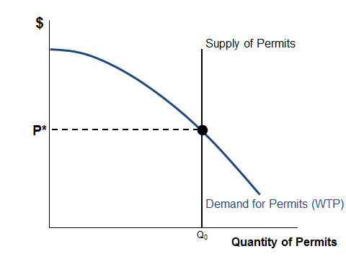
Figure 19: Determination of Carbon Permit Price
Note: WTP = Willingness to pay.

Slide 27
Figure 20: Carbon Reduction Options with a Permit System
Marginal cost of carbon reduction by plant replacement
Marginal cost of carbon reduction by energy efficiency
Marginal cost of carbon reduction by forest expansion
P*
Q_{PR}
Q_{EE}
Q_{FE}
Units of carbon reduced by plant replacement
Units of carbon reduced by energy efficiency
Units of carbon reduced by forest expansion
Note: Marginal costs shown here are hypothetical.

Slide 28
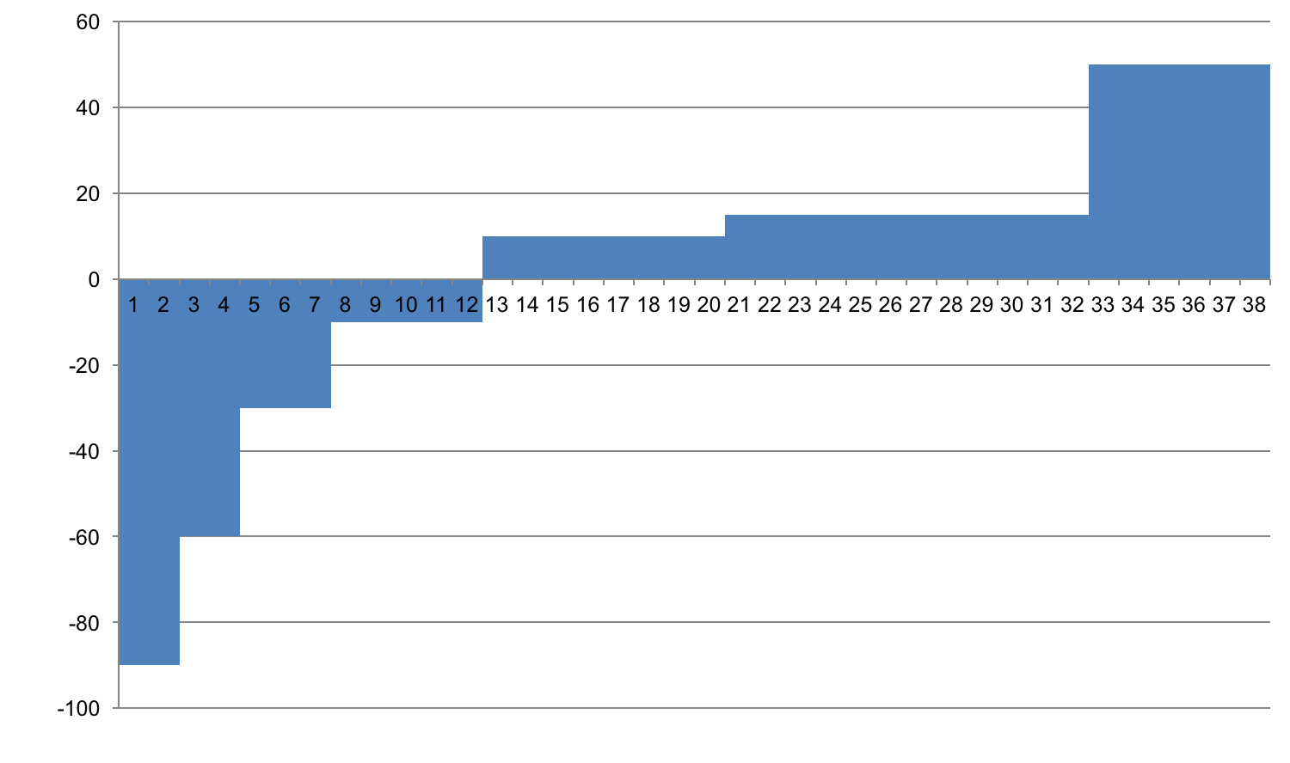
Figure 21: Global Greenhouse Gas Abatement Cost Curve for 2030
Carbon capture and storage, reduced intensive agriculture conversion
New building efficiency, pasture, grassland, soil and forest management
Wind and solar power, forest restoration
Waste recycling, small hydro, other efficiency improvement
Abatement cost (€ per tCO₂e)
Hybrid cars, electricity from landfill gas, other industrial efficiency
Improved cropland management, insulation retrofit (residential)
Efficiency improvement, LED lighting, insulation retrofit (commercial)
Source: Adapted from McKinsey & Company, 2009.
Abatement potential (GtCO₂e per year)

Slide 29
Table 5: Important Events in International Climate Change Negotiations
Year, Location | Outcome
1992, Rio de Janeiro | UN Framework Convention on Climate Change (UNFCCC). Countries agree to reduce emissions with “common but differentiated responsibilities.”
1995, Berlin | The first annual Conference of the Parties to the framework, known as a COP. U.S. agrees to exempt developing countries from binding obligations.
1997, Kyoto | At the third Conference of the Parties (COP-3) the Kyoto Protocol is approved, mandating developed countries to cut greenhouse gas emissions relative to baseline emissions by 2008-2012 period.
2001, Bonn | (COP-6) reaches agreement on terms for compliance and financing. Bush administration rejects the Kyoto Protocol; U.S.is only an observer at the talks.
2009, Copenhagen | COP-15 fails to produce a binding post-Kyoto agreement, but declares the importance of limiting warming to under 2°C. Developed countries pledge $100 billion in climate aid to developing countries.
2011, Durban | (COP-17) participating countries agreed to adopt a universal legal agreement on climate change as soon as possible, and no later than 2015, to take effect by 2020.
2015, Paris | COP-21 195 nations sign the Paris Agreement, providing for worldwide voluntary actions (INDC’s) by individual countries.

Slide 30
Figure 22: Business as Usual, Paris Pledges, and 2°C Path
150
+4.5°C
120
Business as usual
90
Pledges
+3.5°C
Gigatons of CO₂ equivalent per year
60
Goal
30
+2°C
Source: http://www.nytimes.com/interactive/2015/11/23/world/carbon-pledges.html?_r=1
Note: 2°C = 3.6°F; 3.5°C = 6.3°F; 2 4.5°C = 8.1°F.
0
2000
2030
2100

Slide 31
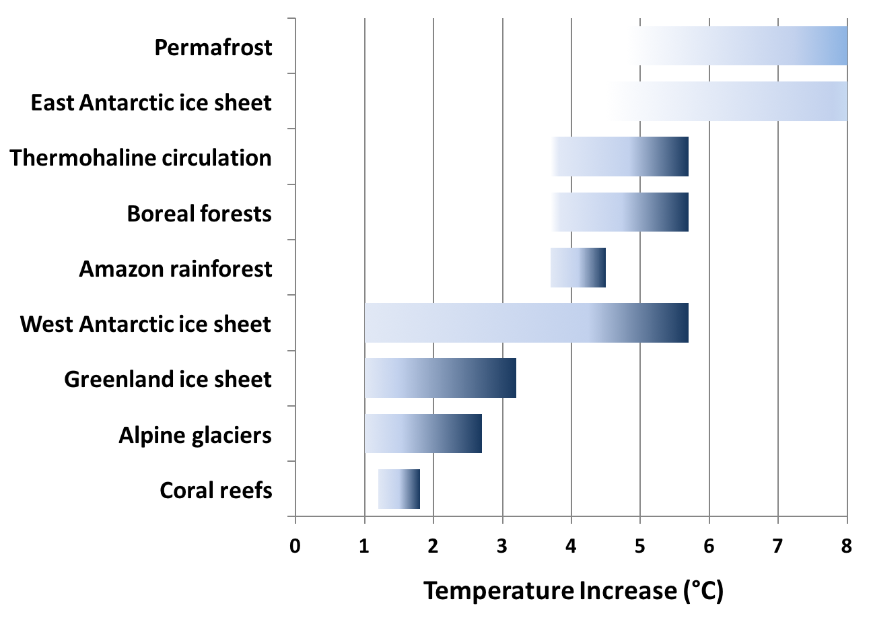
Figure 23: Paris Climate Targets and Catastrophic Impacts
Source: Schellnhuber et al, 2016.
Note: The vertical bar represents the range of the Paris climate targets, from 1.5°C to 2.0°C

